Slide 1
Twitter Sentiment Analysis
103820004 傅俊魁 - 動機發想與報告
103820010 商資穎 - 程式開發與撰寫
103820019 王怡萱 - 文獻回顧與研究

Slide 2
動機介紹
The world is no longer governed by facts and truths. In this postmodern world, we are told not to trust the news, our leaders, and the things that we hold true and fair in our heart. Journalists, reporters, and critics are no longer championed and trusted, and radical hosts in the likes of Bill O’ Reilly and Alex Jones are now considered to be truth-speakers who “obtains fact from their heart” and reports facts “as it is”. It is clear that the general public no longer crave for knowledge, insight, and truth, and how things “feel” would now matter more than how things really are.
Looking at the current landscape for Movie consumption, we realize that the only grading systems of in theatre movies are only from critics, experts, and the so-called “register users”. It grades movies and television shows from its artistic values, its depth in its writing, and its performance, rather than the gut feeling of the general public. Most importantly, these grading systems discriminates and excludes the opinions of those who have yet to watch the movie. Thus, we aim to provide a grading system based on the people - a twitter sentiment analysis of movies based on the most recent tweets about the movie - and provide the post-truth believers a platform to learn about the general public's’ opinion about a movie, regardless of whether they have watched the movie or not.

Slide 3
計畫目標
Collect and Build a Twitter Sentiment Dataset
Train a Twitter Sentiment Classification Tool
Implement the said Sentiment Classification Tool on Recently Released Movies

Slide 4
模型建立流程
輸入資料統一化
訓練Word Vector模組
將字庫Clusterize, 並且map到word_vector
以cluster後的word_vector透過Random Forest Classifier建立模組

Slide 5
模型使用流程
載入word_vector_centroid_map及訓練後之Classifier
使用者輸入欲查詢之字詞及希望查詢母數
透過twitter api載入字串並統一化
將字串用centroid map代換後放入classifier判斷

Slide 6
資料來源
Dataset - Stanford Twitter Sentiment Dataset
Collection Method - Assuming tweets with ‘:)’ are positive tweets, and ‘:(‘ to be negative.
Data Size - 1600000 Labeled Tweets (With 100706890 raw words and 2683104 Sentences)

Slide 7

1. Normalization
2. Vectorization
3. Clusterization
4. Classification
Twitter API

Slide 8
1. Normalization
2. Vectorization
3. Clusterization
4. Classification
1. Remove @handlers from tweet.
2. Remove URLs
3. Remove ‘RT’s
4. Remove #Hashtags
Natural Language Toolkit (NTLK)
Tokenizer
Remove Punctuation
Divide by word

Slide 9
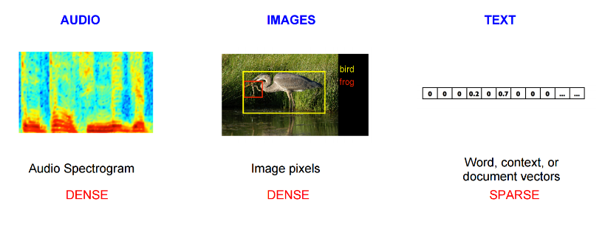
1. Normalization
2. Vectorization
3. Clusterization
4. Classification
Vectorization of Words
Based on Distributional Hypothesis - words that appear in the same contexts share semantic meaning

Slide 10
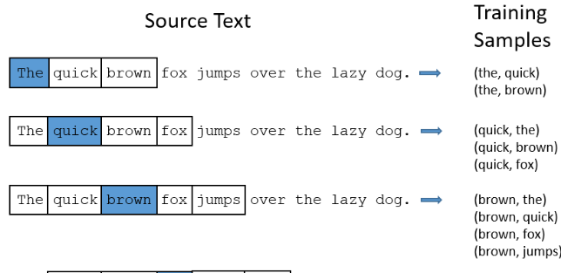
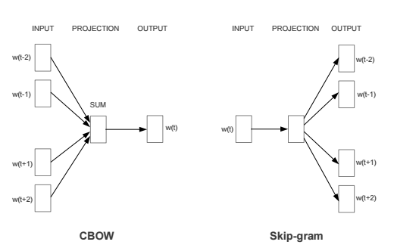
1. Normalization
2. Vectorization
3. Clusterization
4. Classification

Slide 11
1. Normalization
2. Vectorization
3. Clusterization
4. Classification
Vectorization of Words
Based on Distributional Hypothesis - words that appear in the same contexts share semantic meaning

Slide 12
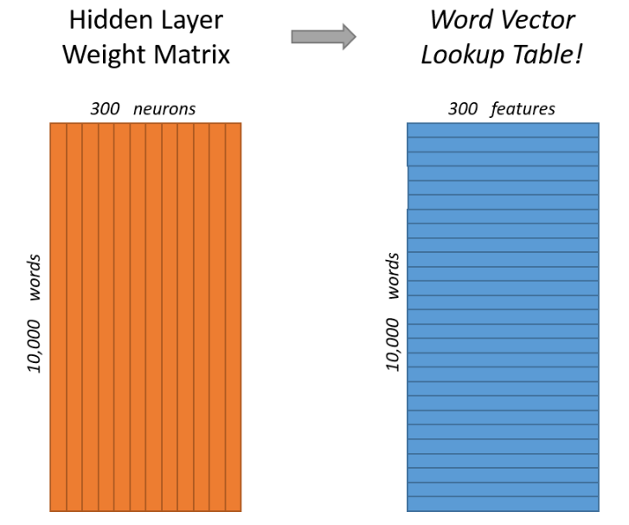
1. Normalization
2. Vectorization
3. Clusterization
4. Classification

Slide 13
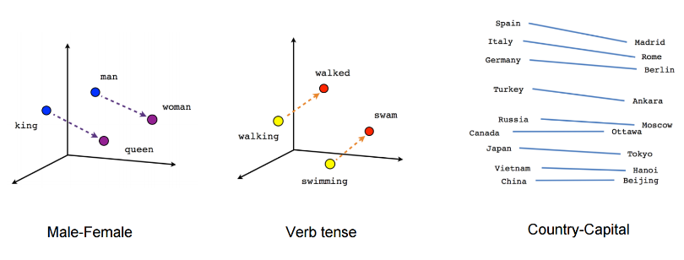
1. Normalization
2. Vectorization
3. Clusterization
4. Classification

Slide 14
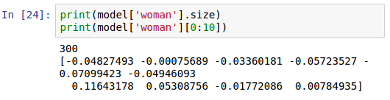
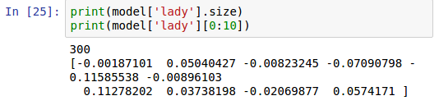
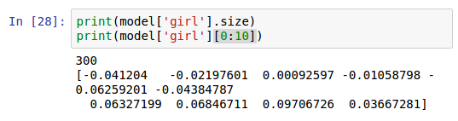
1. Normalization
2. Vectorization
3. Clusterization
4. Classification

Slide 15
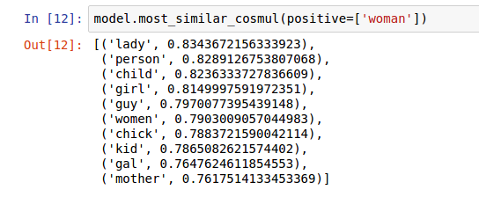
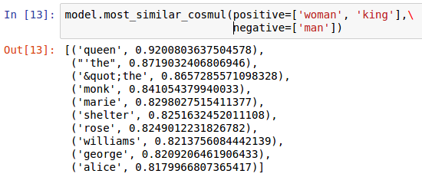
1. Normalization
2. Vectorization
3. Clusterization
4. Classification

Slide 16
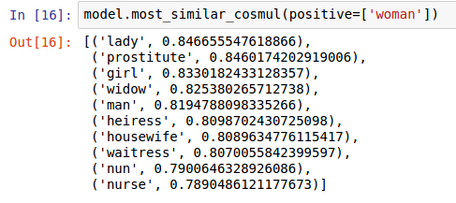
1. Normalization
2. Vectorization
3. Clusterization
4. Classification

Slide 17
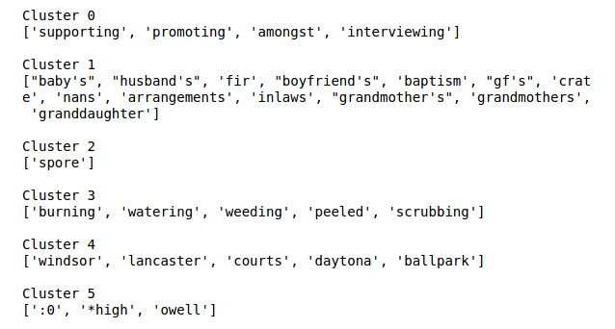
1. Normalization
2. Vectorization
3. Clusterization
4. Classification

Slide 18
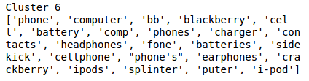



1. Normalization
2. Vectorization
3. Clusterization
4. Classification

Slide 19
1. Normalization
2. Vectorization
3. Clusterization
4. Classification
Create Bag of Centroids
Loop over the words in the review. If the word is in the vocabulary, find which cluster it belongs to, and increment that cluster count by one

Slide 20
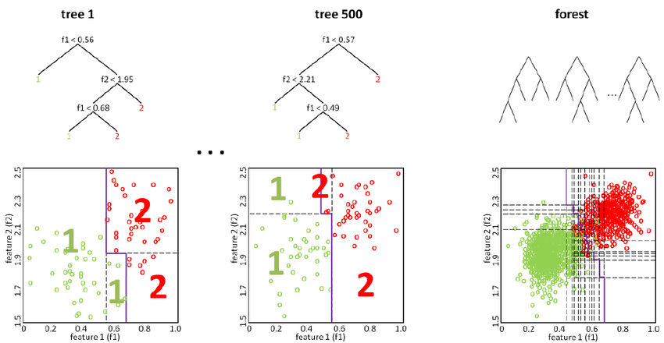
1. Normalization
2. Vectorization
3. Clusterization
4. Classification
Random Forest Classifier

